Slide 1



Mind Sculptor
An Obsessive-Compulsive Disorder(OCD) Exposure and Response Prevention(ERP) Therapy Tool
24-25J-046

Slide 2
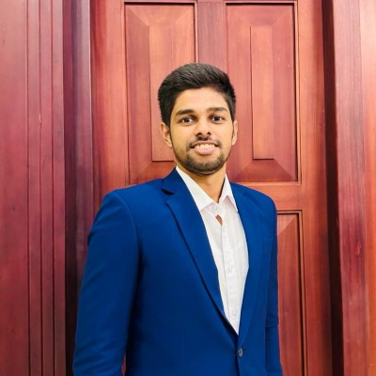
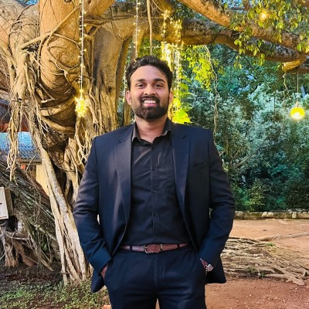
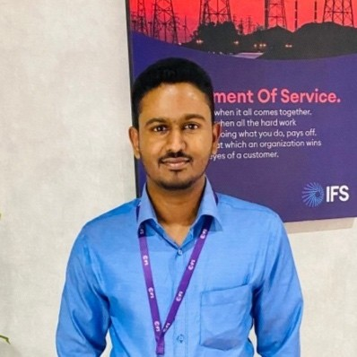
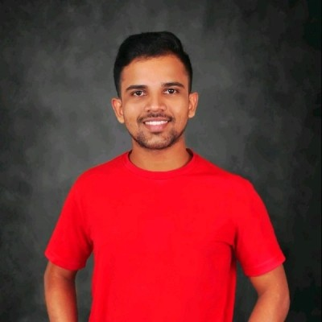
Our Team
Jayasighe P.T.
IT21234484
Mallawaarachchi D.E.H.
IT21209420
Illesinghe A.T.
IT21286278
Vithanage C.S.
IT21219498

Slide 3
INTRODUCTION
Obsessive-Compulsive Disorder(OCD) is a chronic psychiatric condition characterized by persistent intrusive thoughts (obsessions) and repetitive behaviors (compulsions).
It affects approximately 2-3% of the population and significantly impairs daily functioning and quality of life.
Traditional ERP therapy is effective but limited by accessibility and engagement challenges.
A comprehensive OCD ERP tool with advanced biometric monitoring and AI-driven therapeutic interventions has been identified as a valuable resource for enhancing the accessibility and effectiveness of obsessive-compulsive disorder treatment

Slide 4

Research Problem
How can AI and voice analysis improve the identification of OCD presence, subtypes and severity levels?
In what ways can biometric data and machine learning algorithms be used to create tailored ERP therapy plans for individual patients?
How can AI-supported Interactive Voice Assistant(IVA) increase patient engagement and accessibility to ERP therapy, particularly for those with logistical or psychological barriers?

Slide 5

Research Objectives
Main Objective
Sub Objectives
Develop an Exposure and Response Prevention(ERP) Therapy tool for patients suffering from OCD.
To enhance the diagnosis and understanding of OCD subtypes
To develop personalized and adaptive ERP therapy plans
To create AI-supported Interactive Voice Assistant(IVA)
To enable remote and real-time monitoring of therapy sessions

Slide 6
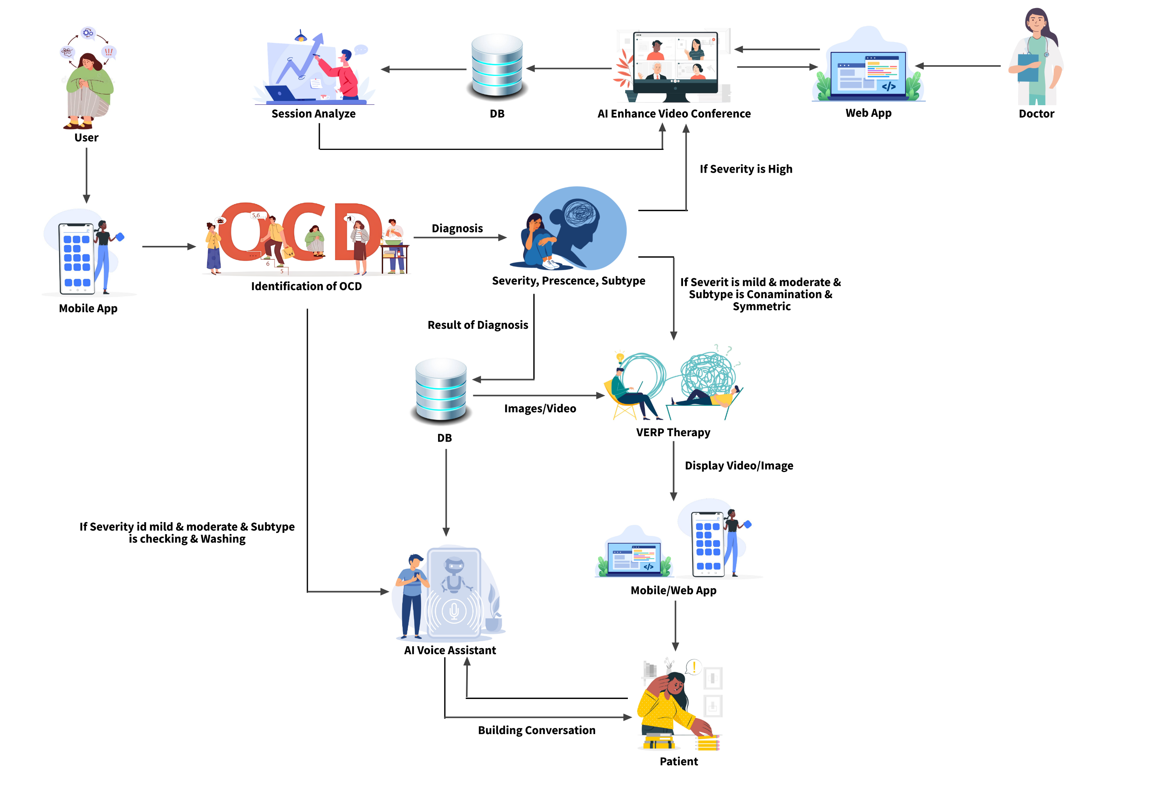
System Diagram

Slide 7
Identify the presence, severity, and sub types of OCD in patients
IT21219498 | Vithanage C.S.
Specialization: Software Engineering
IT21219498 | Vithanage C.S | 24 – 25J – 046

Slide 8

Introduction
Background on OCD
Obsessive-Compulsive Disorder (OCD) is a mental health condition characterized by unwanted and intrusive thoughts (obsessions) and repetitive behaviors (compulsions).
It affects individuals' daily functioning and quality of life.
Importance of the Study
Identifying the presence, severity, and sub-types of OCD can lead to better diagnosis, treatment, and understanding of the disorder.
Accurate assessment helps in providing tailored interventions and improving patient outcomes.
IT21219498 | Vithanage C.S | 24 – 25J – 046

Slide 9
Research Gap
Feature | Proposed System | GGOC: OCD Relief [1] | nOCD [2] | TalkSpace [3] | OCD Challenge
Dynamic Questionnaires | ✔ | ❌ | ✔ | ❌ | ✔
Explain OCD Episodes as Voice | ✔ | ❌ | ❌ | ❌ | ❌
Keyword Detection in Voice | ✔ | ❌ | ❌ | ❌ | ❌
Voice Pitch Fluctuation Analysis | ✔ | ❌ | ❌ | ❌ | ❌
Accurate Diagnosis | ✔ | ❌ | ❌ | ❌ | ❌
Data Privacy | ✔ | ✔ | ✔ | ✔ | ✔
IT21219498 | Vithanage C.S | 24 – 25J – 046

Slide 10

Research Questions
Primary Questions
How can the presence of OCD be accurately identified in patients using modern technological methods?
What are the most effective techniques to determine the severity of OCD symptoms?
How can different sub-types of OCD be classified and differentiated in patients?
Secondary Questions
Can voice recordings and speech analysis provide additional insights into OCD symptoms?
What algorithms and techniques are most suitable for these assessments?
IT21219498 | Vithanage C.S | 24 – 25J – 046

Slide 11

Objectives
Main Objective
Sub Objectives
Develop a comprehensive assessment method for identifying the presence, severity, and sub-types of OCD in patients.
Questionnaire-Based Assessment:
Implement a dynamic questionnaire to provide a preliminary diagnosis based on user responses.
Keyword Detection from Voice Recordings:
Use ASR APIs and algorithms like TF-IDF and SVM to detect keywords from voice recordings for diagnosis.
Voice Pitch Fluctuation Analysis:
Analyze voice pitch fluctuations to assess emotional state and severity of OCD.
Final Diagnosis:
Combine results from all sub-components to produce a comprehensive OCD diagnosis.
IT21219498 | Vithanage C.S | 24 – 25J – 046

Slide 12
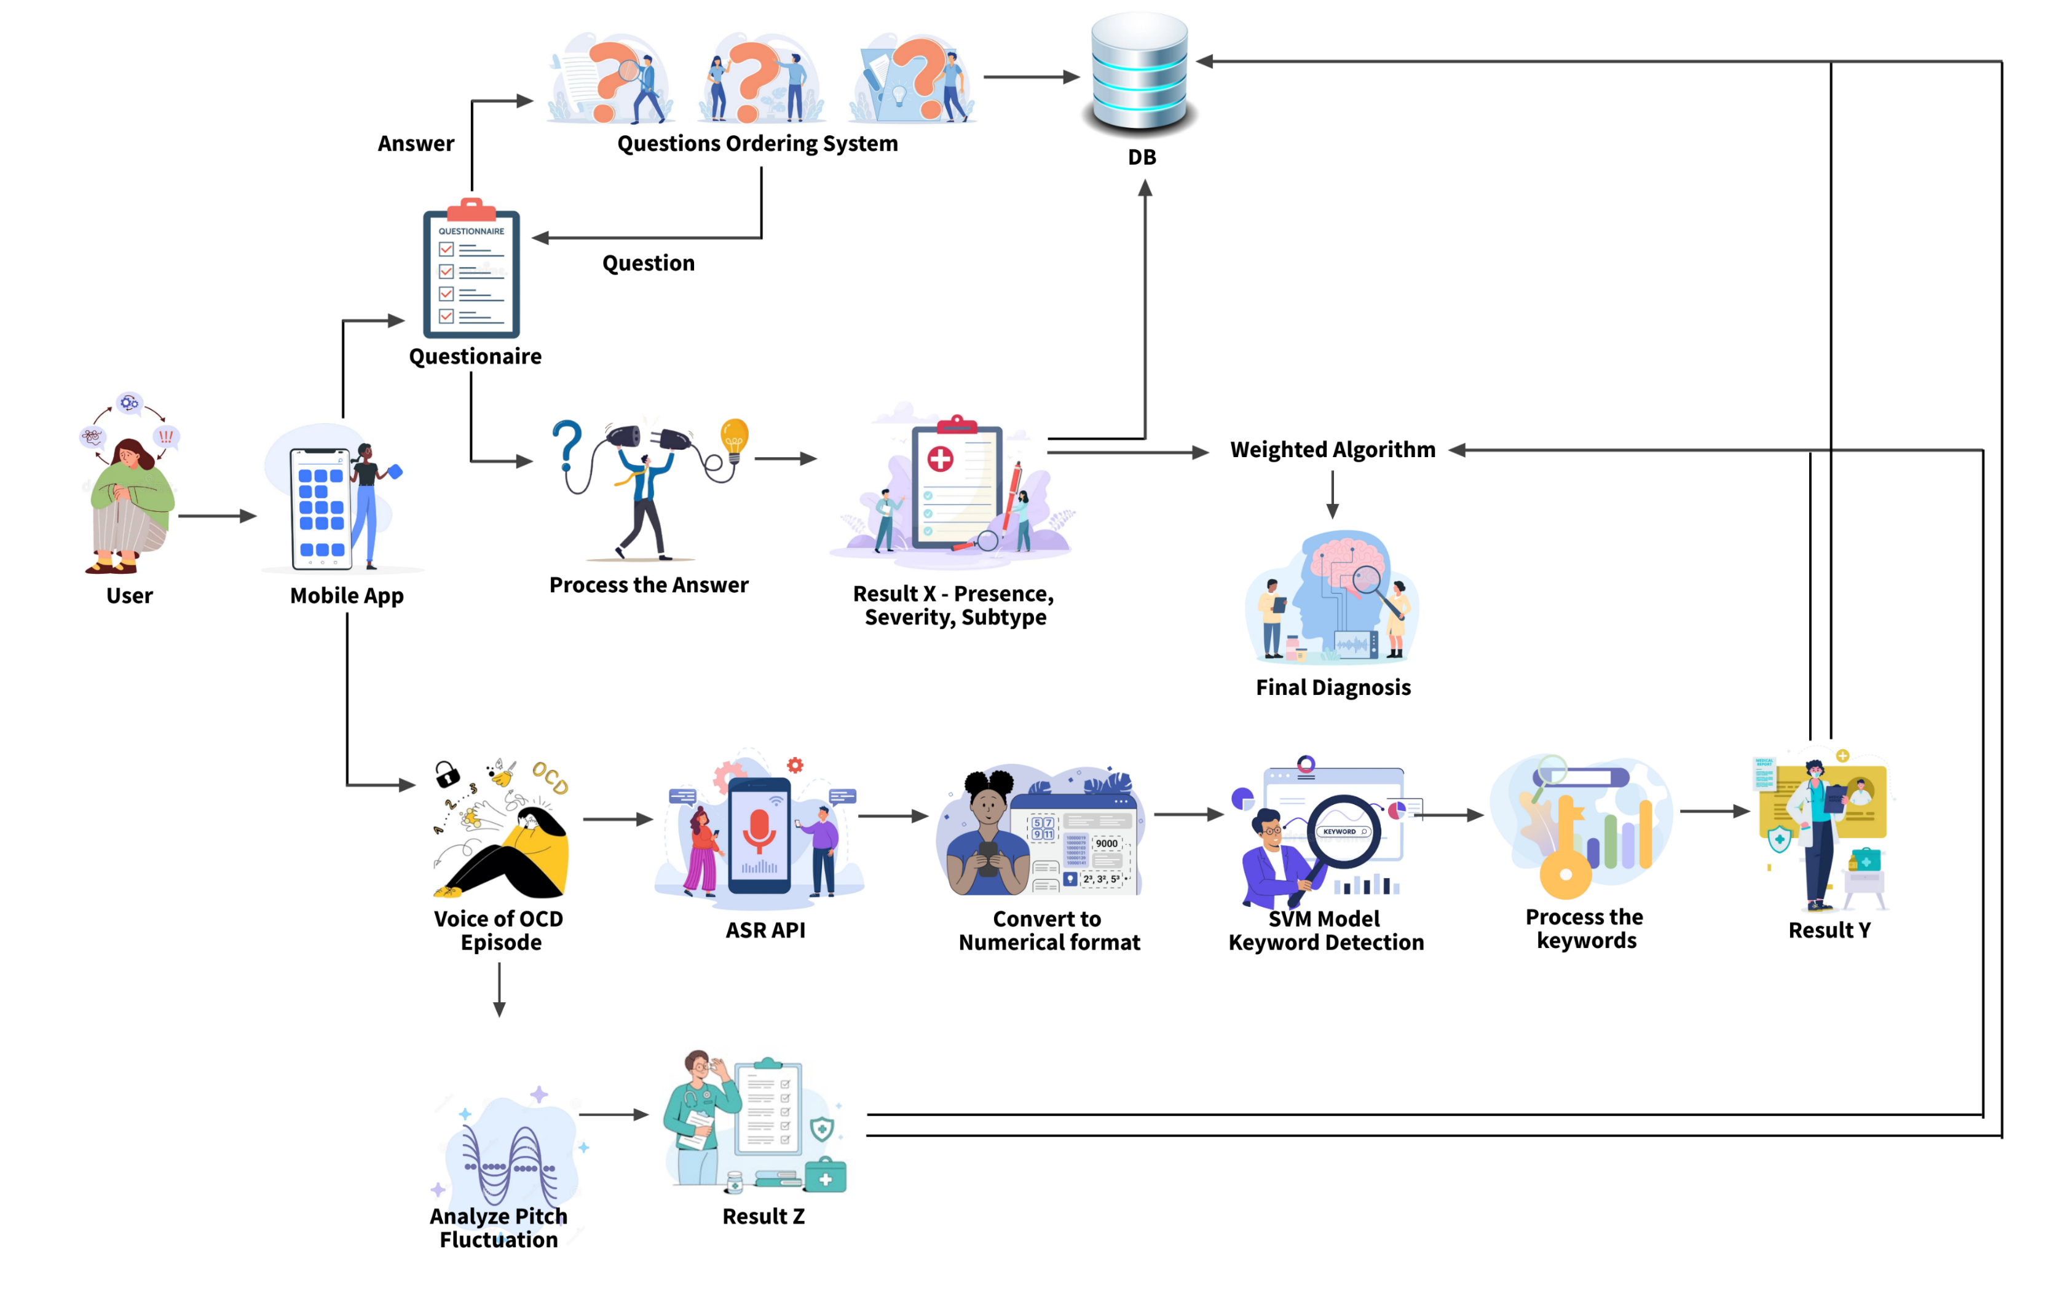
Methodology – System Diagram
IT21219498 | Vithanage C.S | 24 – 25J – 046

Slide 13
Novelty Features
Keyword Detection from Voice Recordings
Technology Used: Automatic Speech Recognition (ASR) APIs (e.g., Google Cloud Speech-to-Text).
Algorithms Employed: Term Frequency-Inverse Document Frequency (TF-IDF) and Support Vector Machine (SVM).
Purpose: Detect relevant keywords from patient voice recordings describing OCD episodes.
Benefits:
Provides an additional layer of diagnostic information.
Enhances the results obtained from traditional questionnaires.
Offers a more comprehensive evaluation of OCD symptoms.
Voice Pitch Fluctuation Analysis
Technology Used: Librosa library for audio analysis.
Purpose: Analyze the fluctuations in voice pitch to assess the emotional state of patients when describing OCD episodes.
Benefits:
Provides insights into the patient's emotional and psychological state.
Helps in assessing the severity of OCD more accurately.
IT21219498 | Vithanage C.S | 24 – 25J – 046

Slide 14
Methodology – Technologies, Techniques, Algorithms
Techniques
Technologies
Algorithms
Expo
React Native
Python
Flask
MongoDb/Mysql
Vscode
Google Colab
Librosa
NLTK
Scikit-learn
TextBlob
Speech recognition
Keyword detection
Machine learning
Data augmentation
TF-IDF
Support Vector Machine algorithm
Decision Tree algorithm
Weighted scoring algorithm
IT21219498 | Vithanage C.S | 24 – 25J – 046

Slide 15
Methodology – Technologies, Techniques, Algorithms
Techniques
Technologies
Algorithms
Expo
React Native
Python
Flask API
MongoDb/Mysql
Vscode
Google Colab
Librosa
NLTK
Scikit-learn
TextBlob
Speech recognition
Keyword detection
Machine learning
Data augmentation
TF-IDF
Support Vector Machine algorithm
Decision Tree algorithm
Weighted scoring algorithm
IT21219498 | Vithanage C.S | 24 – 25J – 046

Slide 16
Methodology – System, Personal, and Software Specification Requirement
Functional Requirements
Develop a dynamic 20-question questionnaire with algorithmic question ordering to assess OCD presence, severity, and subtype.
Capture and convert patient voice recordings to text using ASR API, and identify keywords using TF-IDF and SVM algorithms to enhance questionnaire results.
Analyze pitch fluctuations using Librosa to derive insights into the patient's emotional state and behavior.
Integrate results from questionnaire, keyword detection, and pitch analysis using ensemble learning for a final diagnosis or severity level.
Non-Functional Requirements
Ensure efficient processing of questionnaire responses and voice data with minimal latency.
Design an intuitive, user-friendly mobile application interface accessible to users with varying technical expertise.
Support multiple users and large datasets, scaling to accommodate growth.
Implement strong encryption for data security, ensuring compliance with GDPR, HIPAA, and other regulations to protect patient confidentiality and handle sensitive information securely.
Software requirements
Python
Flask
React Native
Librosa
ASR APIs
Google Colab
NLTK, scikit-learn, Gensim, TextBlob
Personal requirements
Dr. Roshan Fernando: Psychiatrist guiding the overall research project, providing insights into OCD diagnosis and treatment methodologies.
Ms. Sandaru Fernando: Psychologist assisting in the development of the dataset and providing expertise in psychological assessment.
IT21219498 | Vithanage C.S | 24 – 25J – 046

Slide 17
Methodology – System, Personal, and Software Specification Requirement
Functional Requirements
Develop a dynamic 20-question questionnaire with algorithmic question ordering to assess OCD presence, severity, and subtype.
Capture and convert patient voice recordings to text using ASR API, and identify keywords using TF-IDF and SVM algorithms to enhance questionnaire results.
Analyze pitch fluctuations using Librosa to derive insights into the patient's emotional state and behavior.
Integrate results from questionnaire, keyword detection, and pitch analysis using ensemble learning for a final diagnosis or severity level.
Non-Functional Requirements
Ensure efficient processing of questionnaire responses and voice data with minimal latency.
Design an intuitive, user-friendly mobile application interface accessible to users with varying technical expertise.
Support multiple users and large datasets, scaling to accommodate growth.
Implement strong encryption for data security, ensuring compliance with GDPR, HIPAA, and other regulations to protect patient confidentiality and handle sensitive information securely.
Software requirements
Python
Flask
React Native
Librosa
ASR APIs
Google Colab
NLTK, scikit-learn, Gensim, TextBlob
Personal requirements
Dr. Roshan Fernando: Psychiatrist guiding the overall research project, providing insights into OCD diagnosis and treatment methodologies.
Ms. Sandaru Fernando: Psychologist assisting in the development of the dataset and providing expertise in psychological assessment.
IT21219498 | Vithanage C.S | 24 – 25J – 046

Slide 18
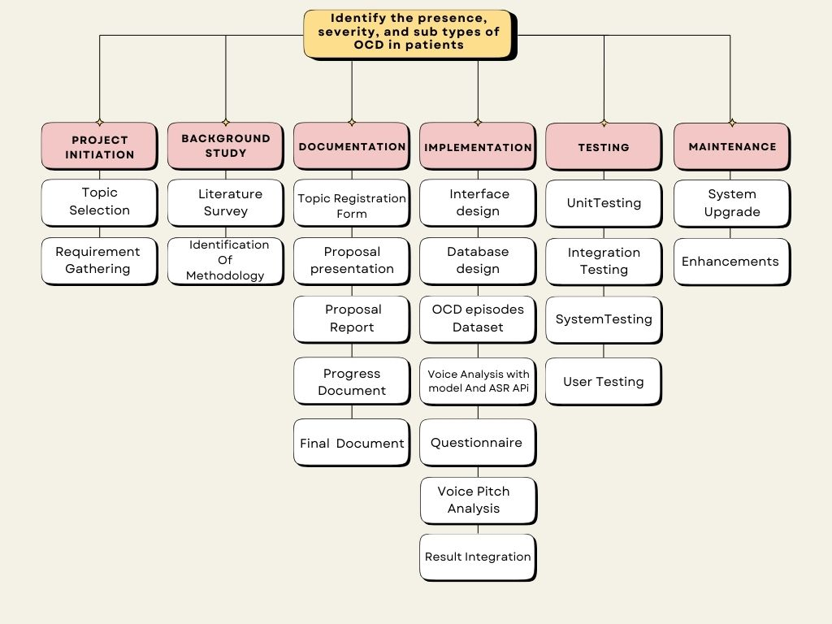
Work Breakdown Structure
IT21219498 | Vithanage C.S | 24 – 25J – 046

Slide 19
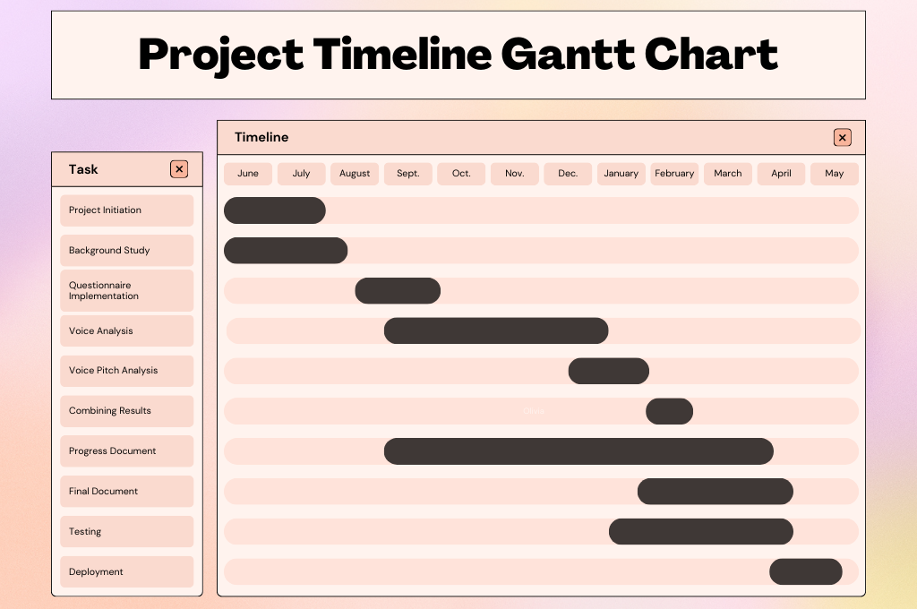
IT21219498 | Vithanage C.S | 24 – 25J – 046

Slide 20
References
[1] B. Pascual-Vera, M. Roncero, G. Doron, and A. Belloch, “Assisting relapse prevention in OCD using a novel mobile app–based intervention: A case report,” Bulletin of the Menninger Clinic, vol. 82, no. 4, pp. 390–406, Dec. 2018, doi: https://doi.org/10.1521/bumc.2018.82.4.390.
‌
[2] M. Gershkovich et al., “Integrating exposure and response Prevention with a mobile app to treat Obsessive-Compulsive Disorder: Feasibility, Acceptability, and preliminary Effects,” Behavior Therapy, vol. 52, no. 2, pp. 394–405, Mar. 2021, doi: 10.1016/j.beth.2020.05.001.
[3] T. D. Hull and K. Mahan, “A Study of Asynchronous Mobile-Enabled SMS Text Psychotherapy,” Telemedicine journal and e-health : the official journal of the American Telemedicine Association, vol. 23, no. 3, pp. 240–247, 2017, doi: https://doi.org/10.1089/tmj.2016.0114.
[4] E. McIngvale, C. Bakos-Block, J. Hart, and P. S. Bordnick, “Technology and Obsessive Compulsive Disorder: An Interactive Self-Help Website for OCD,” Journal of Technology in Human Services, vol. 30, no. 2, pp. 128–136, Apr. 2012, doi: https://doi.org/10.1080/15228835.2012.699368.
‌
IT21219498 | Vithanage C.S | 24 – 25J – 046

Slide 21
Enhanced Exposure and Response Prevention Therapy
IT21286278 | Illesinghe A.T.
Specialization: Software Engineering
IT21286278 | Illesinghe A. T. | 24 – 25J – 046

Slide 22
Introduction
Background
Exposure and Response Prevention(ERP) therapy is commonly used treatment by psychiatrists for patients diagnosed with Obsessive-Compulsive Disorder(OCD).
Exposure and Response Prevention(ERP) therapy, have proven effective in reducing symptoms and improving outcomes for OCD patients.
Enhanced Exposure and Response Prevention(VERP) is an innovative approach to treating OCD patients.
VERP uses advanced technology to simulate OCD-inducing scenarios and integrates biometric data to enhance the effectiveness of traditional exposure therapy.
VERP can be used to treat patients with symmetric OCD, contamination OCD, sexual orientation OCD.
IT21286278 | Illesinghe A. T. | 24 – 25J – 046

Slide 23

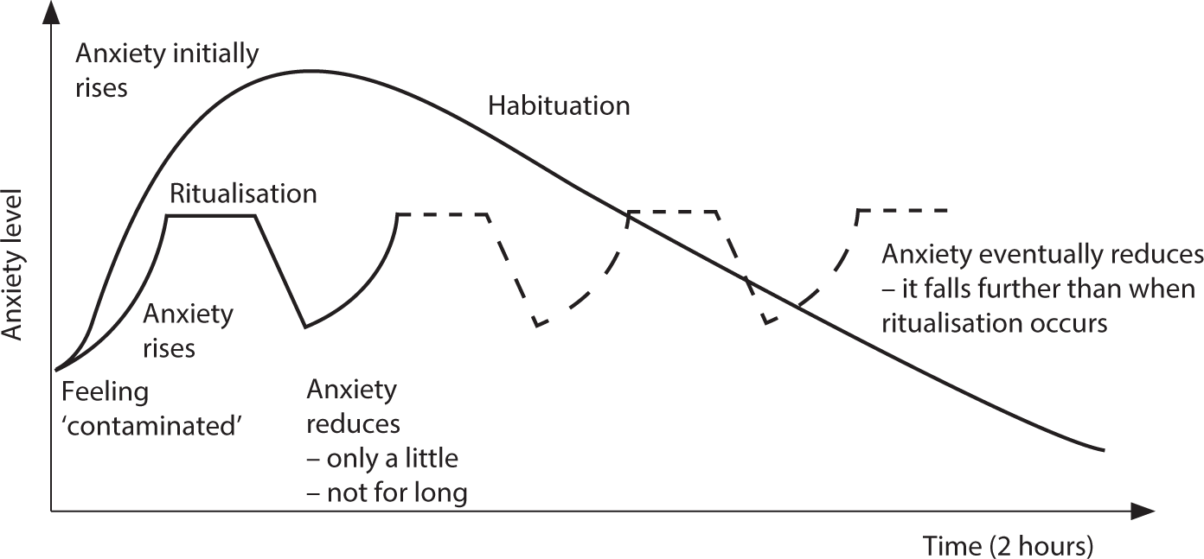
Introduction
Importance of the Study
First, the patient is exposed to an OCD-inducing scenario using images/videos.
Then the anxiety graph is generated using patient self-reported data and bio metric data.
Patients can seek the therapy on their own without consulting a doctor and reduce the symptoms of the OCD.
Patients can monitor the effectiveness of treatment by analyzing anxiety charts.
Contamination OCD
Anxiety graph
IT21286278 | Illesinghe A. T. | 24 – 25J – 046

Slide 24
Research Gap
Feature | Proposed System | GGOC: OCD Relief [1] | NOCD [2] | TalkSpace [3] | OCD Challenge [4]
Expose the user to OCD-triggering situations. | ✔ | ❌ | ✔ | ❌ | ✔
Capture stress/anxiety level using facial expressions | ✔ | ❌ | ❌ | ❌ | ❌
Generate anxiety graph after VERP therapy | ✔ | ❌ | ❌ | ❌ | ❌
Treatment efficacy analysis | ✔ | ✔ | ❌ | ✔ | ❌
IT21286278 | Illesinghe A. T. | 24 – 25J – 046

Slide 25
Research Questions
How can we virtually expose patients to OCD inducing scenarios?
How can response prevention therapy be implemented using modern technology?
How can the accuracy of response prevention therapy be increased using modern technology?
IT21286278 | Illesinghe A. T. | 24 – 25J – 046

Slide 26
Objectives
Main Objective
Sub Objectives
Simulate real-life scenarios using tailored videos and images to expose the patient to OCD triggering scenario.
Capture biometric data and patient self-reported data during therapy session.
Generate the anxiety graph using captured biometric data and self-reported data.
Analyze anxiety graphs to predict the patient’s treatment efficacy.
To develop a therapy system that utilizes virtual simulations and biometric data to effectively treat Obsessive-Compulsive Disorder (OCD).
IT21286278 | Illesinghe A. T. | 24 – 25J – 046

Slide 27
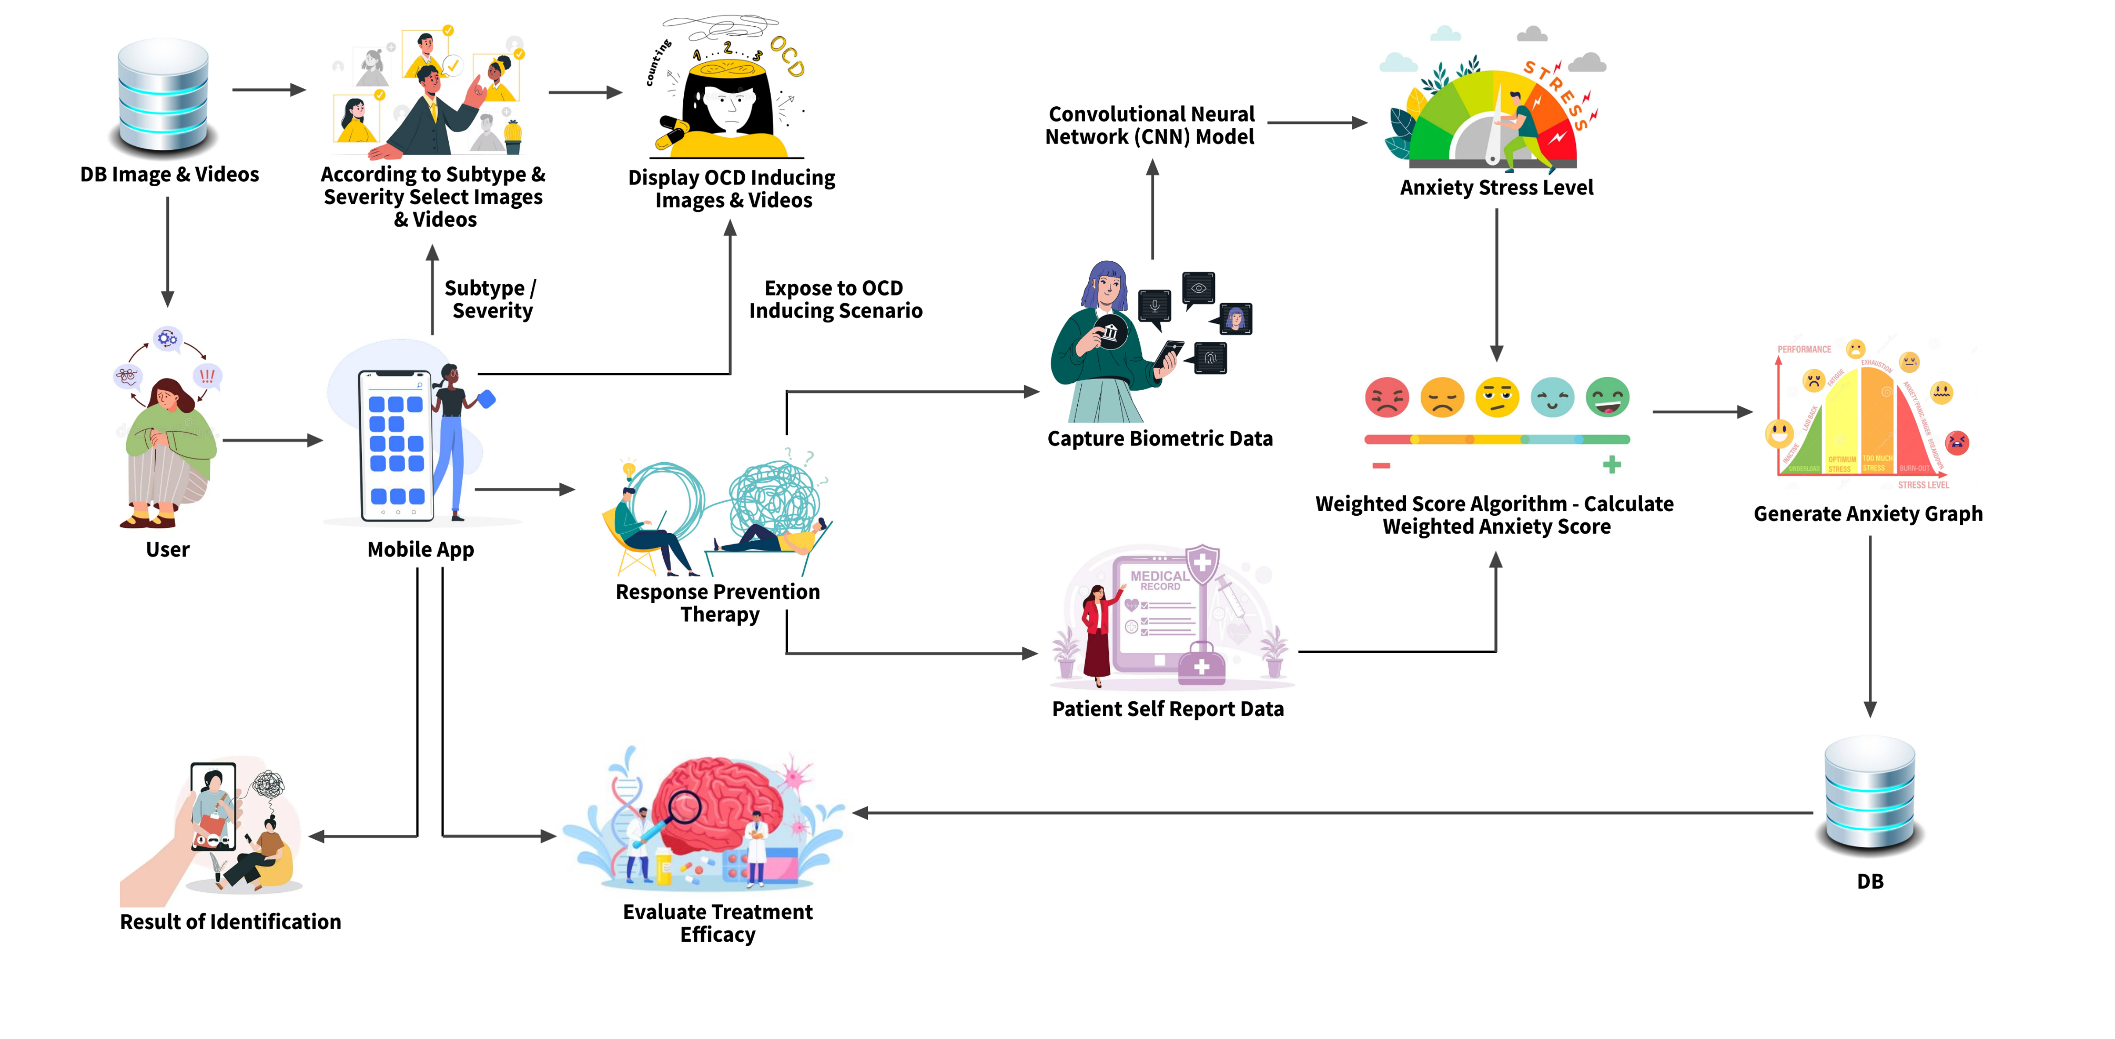
Methodology – System Diagram
IT21286278 | Illesinghe A. T. | 24 – 25J – 046

Slide 28
Novelty Feature
Integrate biometric data with patient self-reported data to draw the anxiety graph more accurately.
IT21286278 | Illesinghe A. T. | 24 – 25J – 046

Slide 29
Methodology – Technologies, Techniques, Algorithms
Techniques
Technologies
Algorithms
Facial recognition
Emotion detection
Machine learning
Deep learning
Graph visualization.
React
Expo
React Native
TensorFlow
Python Flask
NodeJs
MongoDb/Mysql
Vscode
Convolutional Neural Network (CNN)
Decision Tree algorithm
Weighted scoring algorithm
CNN architectures
VGG-Face
Google Facenet
OpenFace
ResNet
IT21286278 | Illesinghe A. T. | 24 – 25J – 046

Slide 30
Methodology – System, Personal, and Software Specification Requirement
Functional Requirements
Display appropriate image/video based on the OCD sub type and severity of the patient.
Capture accurate anxiety/stress level using emotion detection during the therapy.
Capture the patient self-reported data.
Calculate the weighted anxiety score accurately using facial expression data and user input data.
Generate the anxiety graph using the weighted anxiety score.
Analyze anxiety graphs of the patient.
Non-Functional Requirements
The application should be reliable and efficient.
Interfaces should be user-friendly.
The application should be compatible with different devices.
Patient data must be secure.
The results of VERP therapy must be accurate.
Software requirements
Python
Node
React
Vscode
MongoDB/Mysql
Personal requirements
Guidance of external supervisors to acquire knowledge of healthcare domain.
Data set to train the CNN model.
IT21286278 | Illesinghe A. T. | 24 – 25J – 046

Slide 31
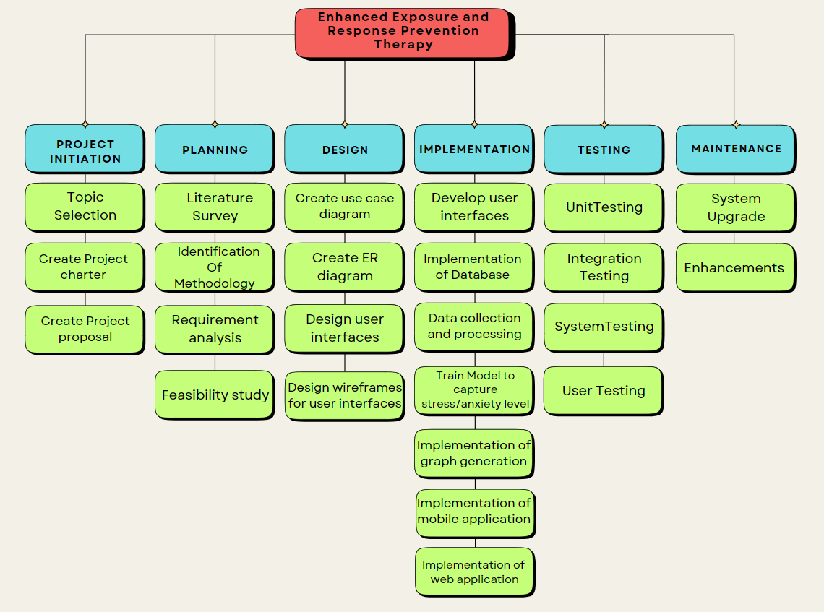
Work Breakdown Structure
IT21286278 | Illesinghe A. T. | 24 – 25J – 046

Slide 32
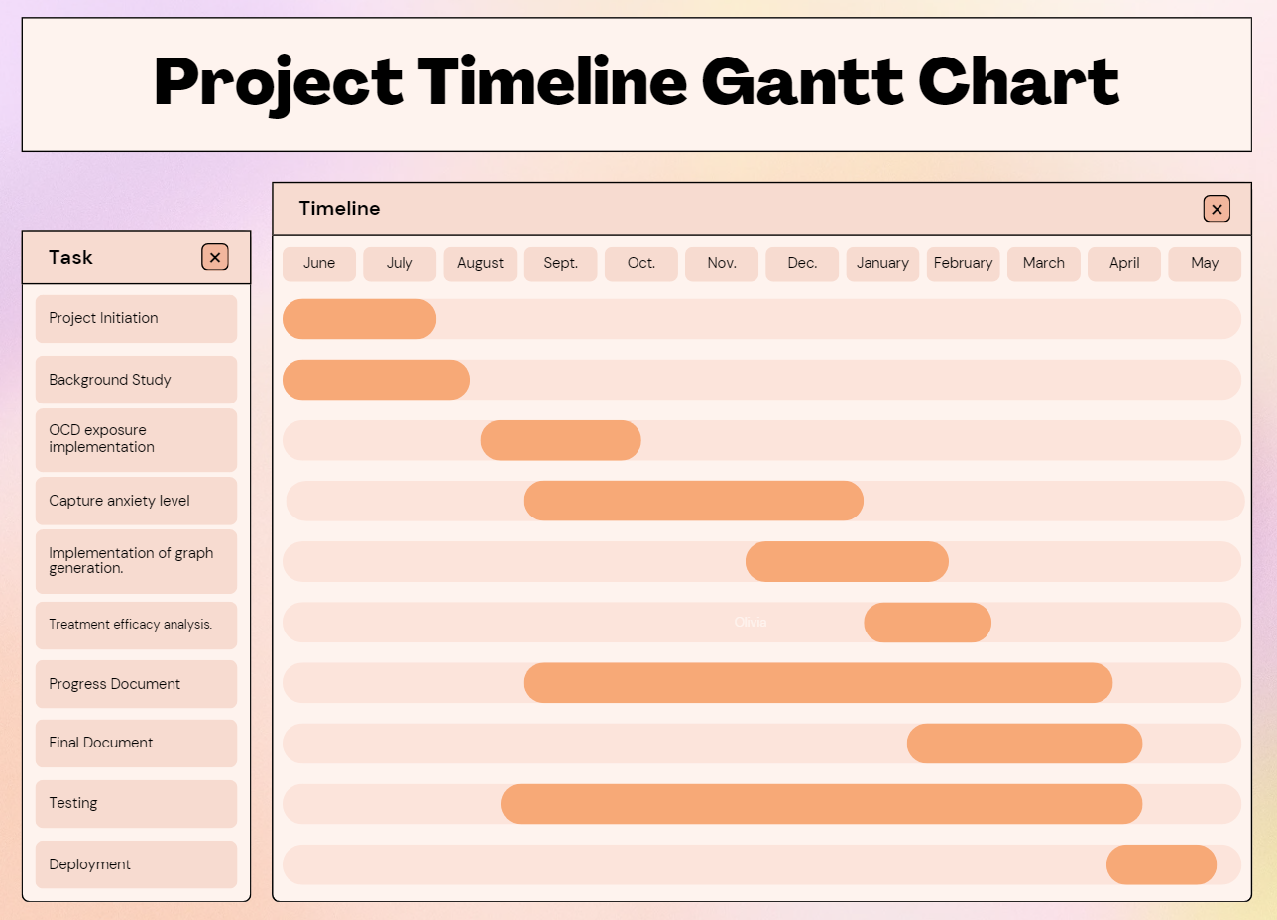
Completion of the project
IT21286278 | Illesinghe A. T. | 24 – 25J – 046

Slide 33
References
[1] B. Pascual-Vera, M. Roncero, G. Doron, and A. Belloch, “Assisting relapse prevention in OCD using a novel mobile app–based intervention: A case report,” Bulletin of the Menninger Clinic, vol. 82, no. 4, pp. 390–406, Dec. 2018, doi: https://doi.org/10.1521/bumc.2018.82.4.390.
‌
[2] M. Gershkovich et al., “Integrating exposure and response Prevention with a mobile app to treat Obsessive-Compulsive Disorder: Feasibility, Acceptability, and preliminary Effects,” Behavior Therapy, vol. 52, no. 2, pp. 394–405, Mar. 2021, doi: 10.1016/j.beth.2020.05.001.
[3] T. D. Hull and K. Mahan, “A Study of Asynchronous Mobile-Enabled SMS Text Psychotherapy,” Telemedicine journal and e-health : the official journal of the American Telemedicine Association, vol. 23, no. 3, pp. 240–247, 2017, doi: https://doi.org/10.1089/tmj.2016.0114.
[4] E. McIngvale, C. Bakos-Block, J. Hart, and P. S. Bordnick, “Technology and Obsessive Compulsive Disorder: An Interactive Self-Help Website for OCD,” Journal of Technology in Human Services, vol. 30, no. 2, pp. 128–136, Apr. 2012, doi: https://doi.org/10.1080/15228835.2012.699368.
IT21286278 | Illesinghe A. T. | 24 – 25J – 046

Slide 34
AI Supported Interactive Voice Assistant
IT21234484 | Jayasinghe P.T.
Specialization: Software Engineering
IT21234484 | Jayasinghe P.T. | 24 – 25J – 046

Slide 35

Novelty
Combine conversational AI with real-time analysis of voice pitch fluctuations to deliver highly personalized interventions.
IT21234484 | Jayasinghe P.T. | 24 – 25J – 046

Slide 36

Stigma in Society
Mental health disorders are often stigmatized, leading to fear of judgment or discrimination.
This stigma prevents many from openly discussing their struggles or seeking help, worsening their condition over time.
Reluctance to Seek Help
Concerns about being labeled or misunderstood result in a hesitation to pursue traditional therapy.
Cultural pressures and misconceptions around mental health reinforce the idea that seeking help is a sign of weakness.
Geographical Barriers
Access to mental health services is severely limited in rural and remote areas, where traveling to see a therapist can be impractical or impossible.
These geographical challenges create a significant gap in mental health care for those living in underserved regions.
Introduction
IT21234484 | Jayasinghe P.T. | 24 – 25J – 046

Slide 37
Research Gap
Feature | Proposed System | Woebot [1] | Wysa [2] | Replika [3] | Youper[4]
Dynamic Questionnaires | ✔ | ❌ | ✔ | ❌ | ✔
Context-aware Responses | ✔ | ✔ | ✔ | ✔ | ❌
ERP Therapy Integration | ✔ | ❌ | ❌ | ❌ | ❌
Patient Progress Tracking | ✔ | ❌ | ❌ | ❌ | ✔
Personalized Therapy Sessions | ✔ | ❌ | ✔ | ✔ | ✔
Data Privacy | ✔ | ✔ | ✔ | ✔ | ✔
IT21234484 | Jayasinghe P.T. | 24 – 25J – 046

Slide 38
Research Questions
How can AI supported Interactive Voice Assistant enhance accessibility and personalization of ERP therapy for OCD patients?
IT21234484 | Jayasinghe P.T. | 24 – 25J – 046

Slide 39
Objectives
Main Objective
Sub Objectives
Conduct ERP Therapy Sessions for OCD Subtypes.
Generate Appropriate Therapeutic Responses
Utilize patient input to dynamically generate and provide personalized therapeutic responses during the therapy session.
Analyze Voice Pitch Fluctuations
Implement voice analysis algorithms to monitor pitch fluctuations, providing real-time assessment of the patient's emotional state during therapy.
Evaluate Patient Progress and Emotional Response
Implementation of an AI-Supported Interactive Voice Assistant for ERP Therapy in OCD
IT21234484 | Jayasinghe P.T. | 24 – 25J – 046

Slide 40
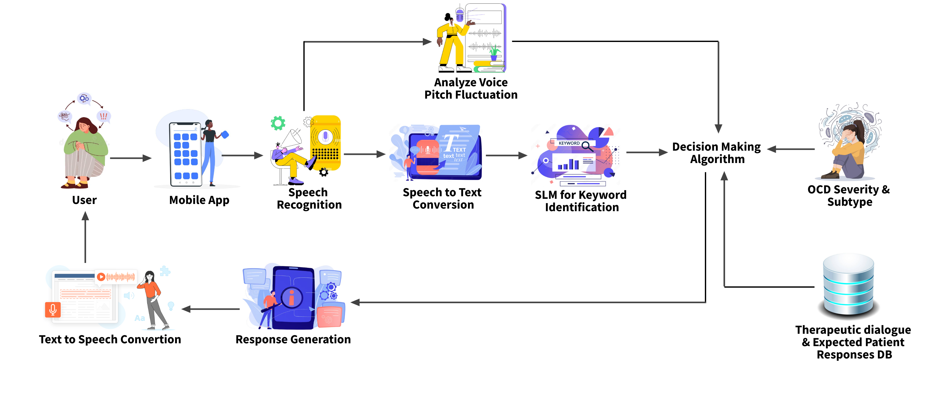
Methodology – System Diagram
IT21234484 | Jayasinghe P.T. | 24 – 25J – 046

Slide 41
Methodology – Technologies, Techniques, Algorithms
Techniques
Technologies
Algorithms
Expo
React Native
Flask
NodeJs
MongoDb/Mysql
Python
Vscode
Google Colab
Librosa
Praat
TensorFlow
Speech recognition
Voice Pitch analysis
Keyword detection
Machine learning
Data augmentation
Logistic Regression algorithm
Decision Tree algorithm
Matching algorithm
IT21234484 | Jayasinghe P.T. | 24 – 25J – 046

Slide 42
Methodology – System, Personal, and Software Specification Requirement
Functional Requirements
Use ‘pyaudio’ to capture audio input from patients for real-time analysis and conversational AI Integration.
Train a supervised learning model to identify OCD-related keywords from transcribed text.
Utilize the Logistic Regression algorithm for precise keyword identification.
Analyze pitch fluctuations to assess emotional state and behavioral insights during therapy sessions.
Create a comprehensive database of therapist dialogues and anticipated patient responses.
Design and implement a matching algorithm to pair identified keywords and emotional states with suitable therapeutic responses
Non-Functional Requirements
Ensure seamless processing of audio data and keyword identification with minimal latency.
Implement a robust and user-friendly interface that allows easy interaction between the IVA and patients.
Ensure scalability to support a growing number of users and expanding datasets
Provide strong data encryption and compliance with GDPR, HIPAA, and other regulations for handling sensitive patient information.
Software requirements
Python
Flask
React Native
Librosa
Praat
Google Colab
NLTK, scikit-learn, Gensim, TextBlob
Personal requirements
Dr. Roshan Fernando: Psychiatrist guiding the overall research project, providing insights into OCD diagnosis and treatment methodologies.
Ms. Sandaru Fernando: Psychologist assisting in the development of the dataset and providing expertise in psychological assessment.
IT21234484 | Jayasinghe P.T. | 24 – 25J – 046

Slide 43
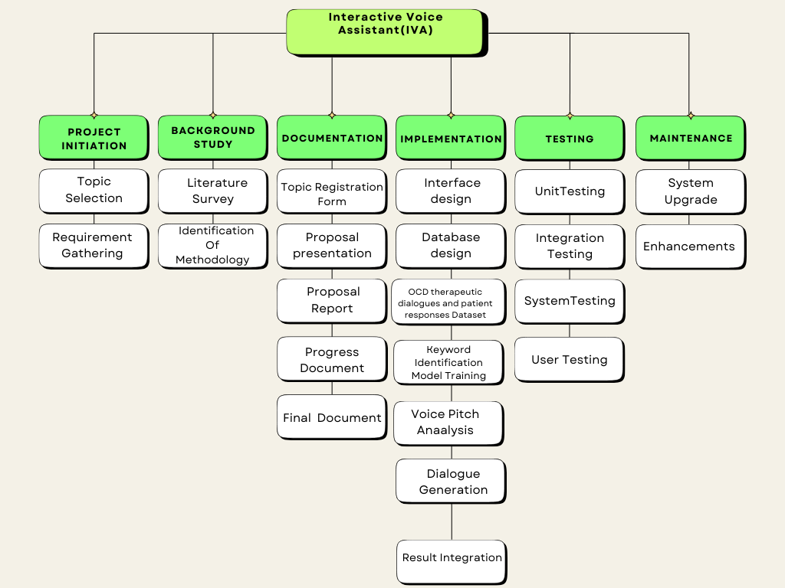
Work Breakdown Structure
IT21234484 | Jayasinghe P.T. | 24 – 25J – 046

Slide 44
Completion of the project
IT21234484 | Jayasinghe P.T. | 24 – 25J – 046

Slide 45
References
[1] Woebot: A mental health chatbot that offers support for anxiety and depression but lacks specialized OCD treatment and ERP integration. [Online]. Available: https://woebothealth.com. [Accessed: Jan. 20, 2024].
[2] Wysa: An AI-powered mental health app with conversational capabilities, focusing on generalized anxiety and mood management but not tailored for OCD or ERP. [Online]. Available: https://wysa.io. [Accessed: Jan. 20, 2024].
[3] Replika: A chatbot designed for companionship and support, offering personalized conversations but not specialized for therapeutic interventions like ERP. [Online]. Available: https://replika.ai. [Accessed: Jan. 20, 2024].
[4] Youper: An AI-powered emotional health assistant that tracks mood and offers CBT-based exercises but does not specifically focus on ERP for OCD. [Online]. Available: https://www.youper.ai. [Accessed: Jan. 20, 2024].
IT21234484 | Jayasinghe P.T. | 24 – 25J – 046

Slide 46
AI-Enhanced Video Conferencing ERP Therapy
IT21209420 | Mallawaarachchi D.E.H.
Specialization: Software Engineering
IT21209420 Mallawaarachchi D.E.H | 24 – 25J – 046

Slide 47

Introduction
Background on OCD
Traditional ERP therapy for OCD needs a lot of time and specialized care, making it hard for many people to access.
Stigma around mental health makes people hesitant to seek help, which worsens their symptoms.
Importance of the Study
AI-enhanced video conferencing can make ERP therapy more accessible and offer personalized, real-time care.
Using biometric analysis, this method can better monitor anxiety and stress levels, improving treatment results.
IT21209420 Mallawaarachchi D.E.H | 24 – 25J – 046

Slide 48
Research Gap
Feature | Proposed System | Zoom for Healthcare [1] | Doxy.me [2] | Talkspace [3] | Lark Health[4]
Real-time Video Conferencing | ✔ | ✔ | ✔ | ✔ | ✔
AI-based Biometric Analysis | ✔ | ❌ | ❌ | ❌ | ✓
Emotion Detection | ✔ | ❌ | ❌ | ❌ | ❌
Session Analytics | ✔ | ❌ | ❌ | ❌ | ❌
Predictive Analytics | ✔ | ❌ | ❌ | ❌ | ❌
Focus on Mental Health | ✔ | ✔ | ✔ | ✔ | ✔
IT21209420 Mallawaarachchi D.E.H | 24 – 25J – 046

Slide 49
Research Questions
Primary Questions
How does AI video therapy help OCD patients access treatment better than in-person therapy?
How effective is AI video therapy in reducing OCD symptoms?
How do patients feel about using AI video therapy? Is it easy and acceptable?
Secondary Questions
How does biometric analysis help track and improve outcomes in AI video therapy?
What are the cost differences between AI video therapy and traditional methods for patients and providers?
IT21209420 Mallawaarachchi D.E.H | 24 – 25J – 046

Slide 50

Objectives
Main Objective
Sub Objectives
Develop an AI-Enhanced Video Conferencing ERP Therapy tool to facilitate more accessible, personalized, and effective OCD treatment.
Real-time Biometric Detection: Implement AI models to capture and analyze facial features for anxiety and stress detection during therapy.
Seamless Video Conferencing: Develop a platform for uninterrupted audio-video communication between patients and therapists.
Session Analytics: Provide detailed session metrics and predictive analytics to monitor patient progress.
Enhanced Feedback: Display critical facial expressions alongside live video for accurate therapist assessment.
IT21209420 Mallawaarachchi D.E.H | 24 – 25J – 046

Slide 51
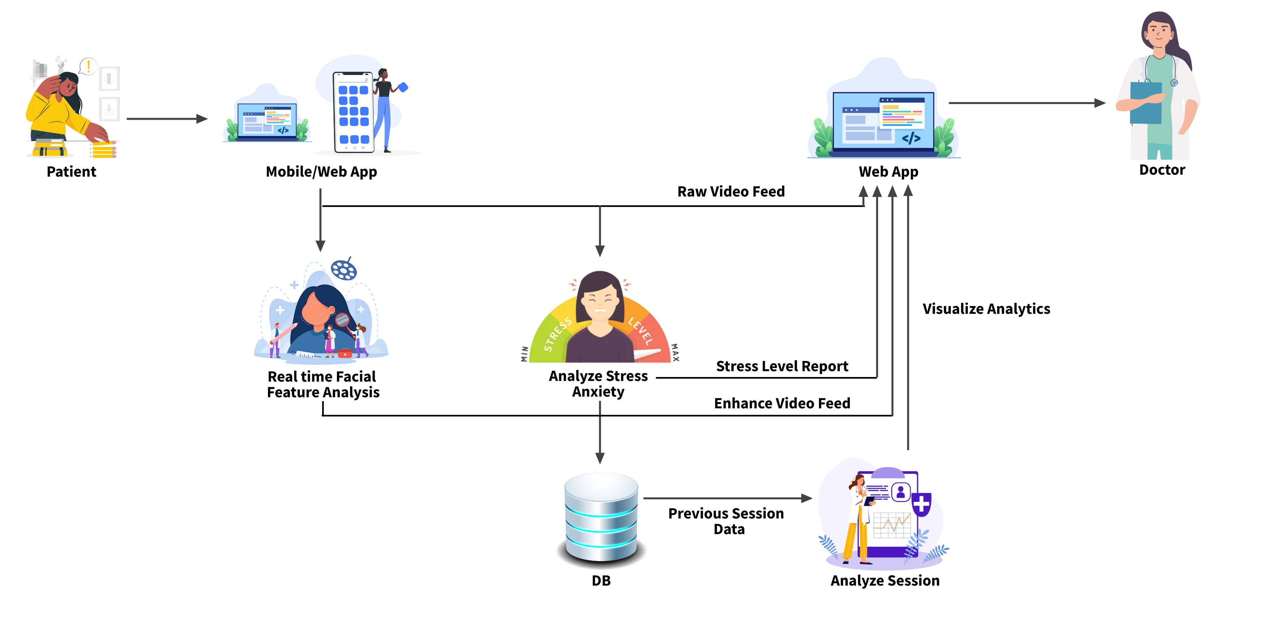
Methodology – System Diagram
IT21209420 Mallawaarachchi D.E.H | 24 – 25J – 046

Slide 52
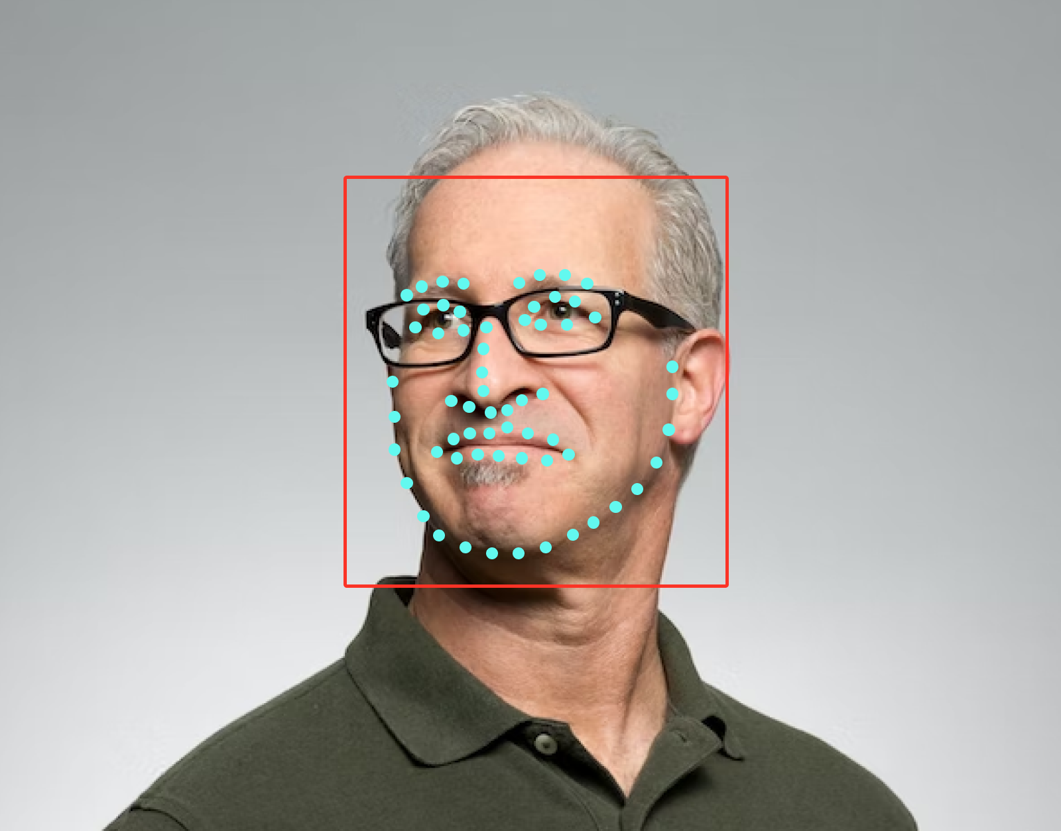
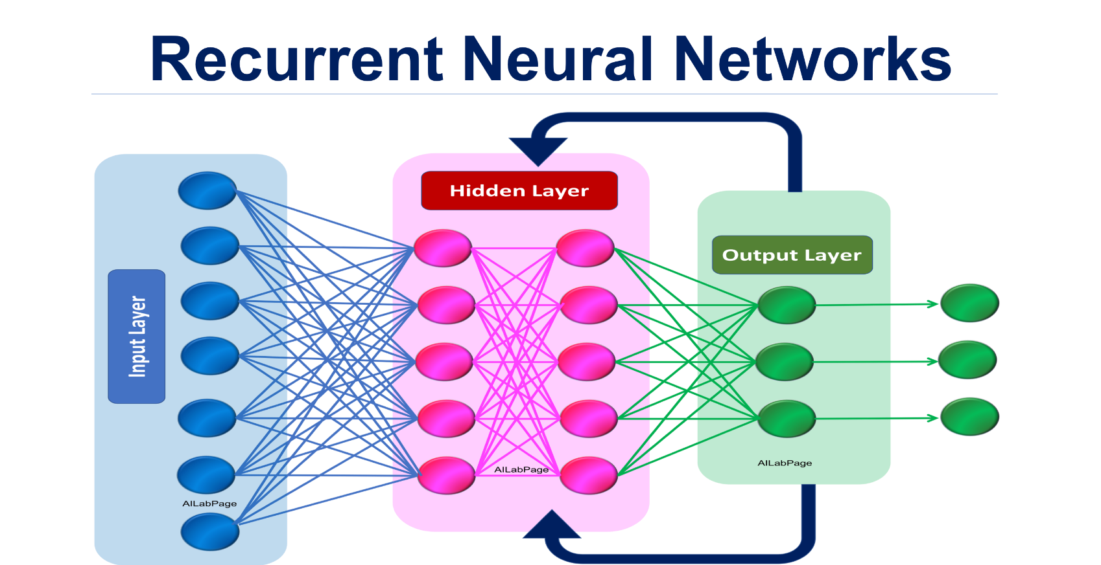
Novelty Feature
Highlight critical biometric facial features on the doctor's screen and stress and anxiety levels to assess the patient’s emotional state accurately and efficiently.
Predict patient improvement based on previous session analytics and estimate the number of sessions required for the patient to become normal
IT21209420 Mallawaarachchi D.E.H | 24 – 25J – 046

Slide 53
Methodology – Technologies, Techniques, Algorithms
Techniques
Technologies
Algorithms
WebRTC
Node.js
socket.io
React
React Native
Python Flask
MongoDB
Facial Recognition
Emotion Detection
Real-time Biometric Analysis
Session Analytics
Data Visualization
FaceNet(CNN)
Dlib’s Model(HOG and CNN)
Linear Regression
Recurrent Neural Networks (RNNs) - LSTM
IT21209420 Mallawaarachchi D.E.H | 24 – 25J – 046

Slide 54
Methodology – Software, Personal, and Software Specification Requirement
Functional Requirements
Real-time biometric analysis results should be displayed accurately to the therapist.
Seamless audio-video communication should be maintained throughout therapy sessions.
Session analytics should provide detailed and accurate metrics.
Critical facial expressions and emotional states should be highlighted accurately for therapist monitoring.
Non-Functional Requirements
Interfaces should be user-friendly and intuitive.
The platform should be compatible with different mobile devices.
The application should be reliable and maintain high availability.
Results should have high accuracy in biometric analysis and emotion detection.
The platform should be efficient in processing and displaying real-time data.
Software requirements
WebRTC
Node.js
React Native
Python Flask
MongoDB
TensorFlow
OpenCV
Personal requirements
Dr. Roshan Fernando: Psychiatrist guiding the overall research project, providing insights into OCD diagnosis and treatment methodologies.
Ms. Sandaru Fernando: Psychologist assisting in the development of the dataset and providing expertise in psychological assessment.
IT21209420 Mallawaarachchi D.E.H | 24 – 25J – 046

Slide 55
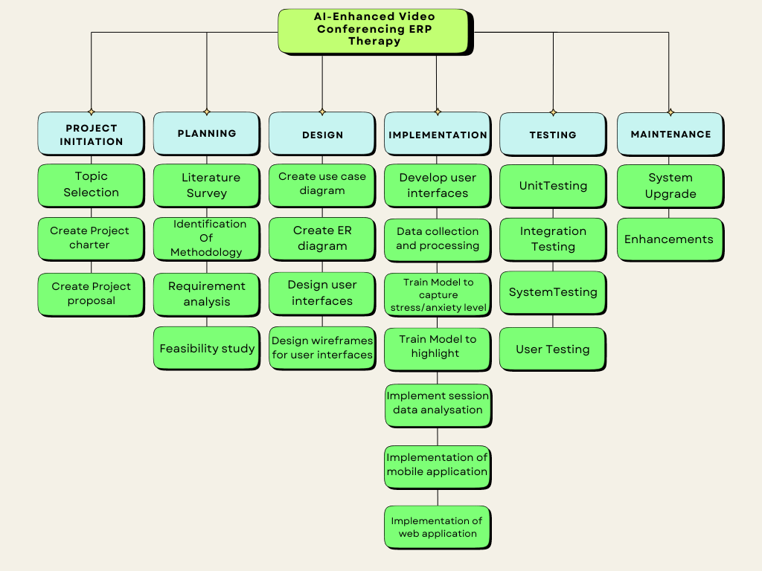
Work Breakdown Structure
IT21209420 Mallawaarachchi D.E.H | 24 – 25J – 046

Slide 56
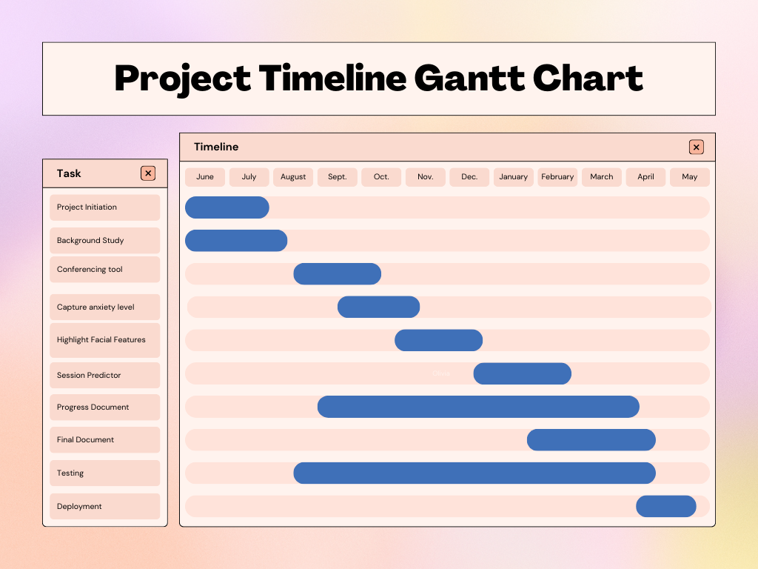
IT21209420 Mallawaarachchi D.E.H | 24 – 25J – 046

Slide 57
References
[1] S. Domb, E. Manly, and D. Elman, “Pandemic patch-up: Using ZoomTM videoconferencing software to create a virtual teaching clinic,” Canadian Family Physician, vol. 67, no. 1, pp. 65–68, Jan. 2021, doi: https://doi.org/10.46747/cfp.670165.
‌
[2] T. Newlin, T. McCall, P. Ottmar, B. Welch, and S. Khairat, “Assessing the Satisfaction of Citizens Using Teleconsent in Clinical Research,” Iospress.nl, pp. 685–689, 2018, doi: https://doi.org/10.3233/978-1-61499-852-5-685.
‌
[3] D. Darnell, M. D. Pullmann, T. D. Hull, S. Chen, and P. Areán, “Predictors of Disengagement and Symptom Improvement Among Adults With Depression Enrolled in Talkspace, a Technology-Mediated Psychotherapy Platform: Naturalistic Observational Study,” JMIR Formative Research, vol. 6, no. 6, p. e36521, Jun. 2022, doi: https://doi.org/10.2196/36521.
[4]K. G. Lockwood et al., “Evaluating a New Digital App–Based Program for Heart Health: Feasibility and Acceptability Pilot Study,” JMIR Formative Research, vol. 8, pp. e50446–e50446, May 2024, doi: https://doi.org/10.2196/50446.
‌
‌
‌
IT21209420 Mallawaarachchi D.E.H | 24 – 25J – 046

Slide 58

Target Audience
1)Individuals with OCD
Demographics: Adults and adolescents diagnosed with OCD.
Needs: Access to effective therapy, personalized treatment plans, and flexible therapy options.
Pain Points: Stigma, geographical barriers, cost, and infrequent therapist availability.
2)Mental Health Professionals
Demographhics :Therapists, psychologists, and psychiatrists specializing in OCD and related disorders.
Needs: Tools for effective patient management, enhanced treatment delivery, and remote therapy capabilities.
Pain Points: Limited time for each patient, difficulty in tracking progress, and need for scalable solutions.
3)Healthcare Institutions
Demographics :Clinics, hospitals, and mental health facilities.
Needs: Integrated solutions for patient care, data management, and evidence-based treatment.
Pain Points: Managing large patient volumes, integrating new technologies, and ensuring data privacy.
Supportive Information
Commerlization
Marketplace
Mental Health Apps Market
Digital Therapy Solutions

Slide 59
Supportive Information
Budget
Component | Description | Price
Development Costs | Salaries for developers, designers, and managers | Rs. 300,000 (one-time)
AI & NLP Tools | Licenses/subscriptions for AI and NLP tools | Rs. 10,000 / year
Biometric Analysis Tools | Tools and libraries for biometric analysis | Rs. 5,000 (one-time)
Cloud Services | Cloud storage and computing power | Rs. 15,000 / year
App Maintenance | Ongoing maintenance and updates | Rs. 15,000 / year
Marketing & Promotion | Digital advertising and promotional events | Rs. 25,000 / year
Customer Support | Support staff salaries and tools | Rs. 20,000 / year
Compliance & Security | Data privacy and security compliance | Rs. 7,000 / year
Training & Documentation | Training materials and user guides | Rs. 4,000 (one-time)
Research & Development | Ongoing R&D for feature improvements | Rs. 12,000 / year

Slide 60
Thank You!

